Slide 1


Prepared by:
Iffa Farhan 2025-GA-32
Shiza Eman 2025-GA-58
Tahira Batool 2025-GA-44
Huma Imam 2025-GA-25
Sabeen Waqas 2025-GA-48

Slide 2

TECH NOVA

Slide 3
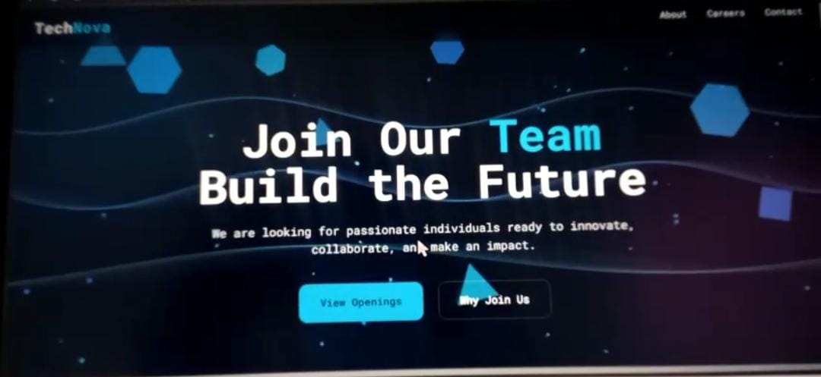
Project Objectives
To design and develop a professional, responsive software agency website.
​To implement semantic HTML5 and external CSS for modern web styling. ​
To quantify project data using MS Excel for business analysis and insights.
​To demonstrate version control and live publishing via GitHub Pages.

Slide 4

Website Overview
Home Page: Introduction to Tech Nova’s mission and services.
​Services Page: Catalog of enterprise software and cloud solutions.
​Careers Page: Job opportunities for developers and QA engineers.
​Contact Page: Professional form for client inquiries and location.

Slide 5
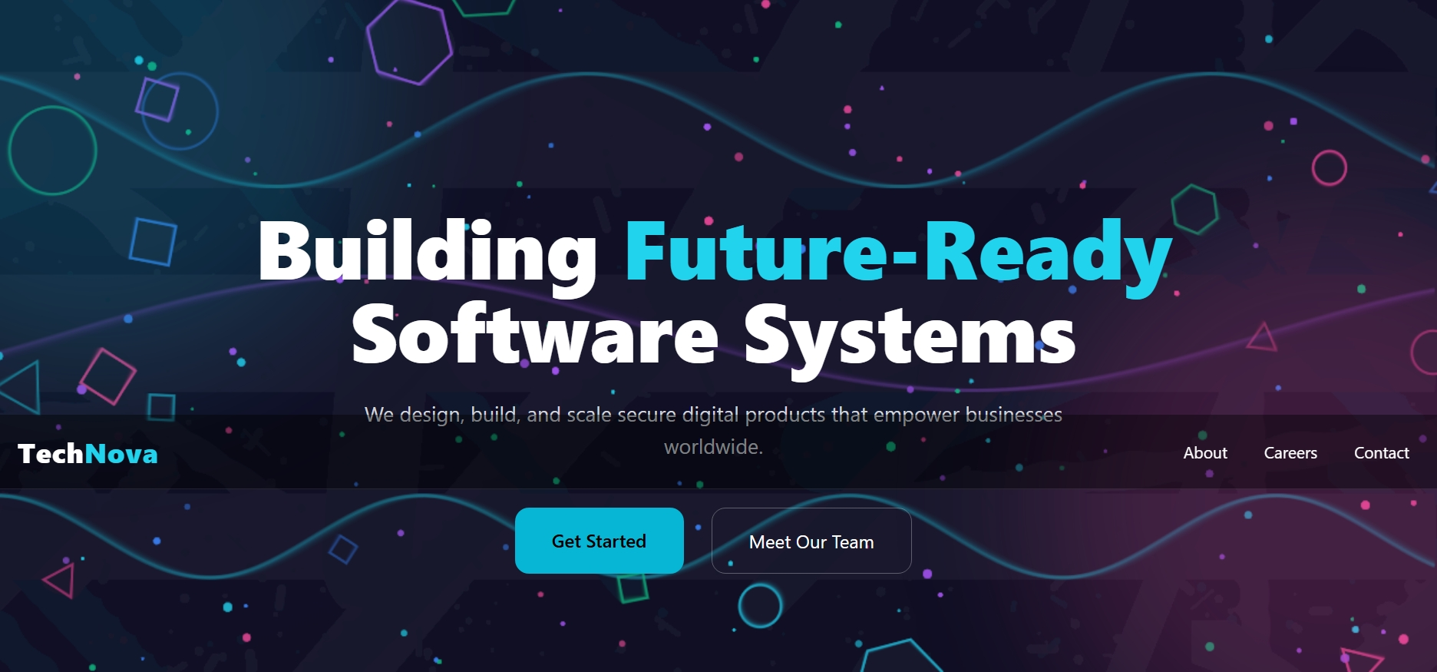
Home Page
Features a sleek, dark-themed hero section with futuristic aesthetics. ​Intuitive navigation bar for an enhanced user experience.
​Built with a focus on responsiveness across various devices.

Slide 6
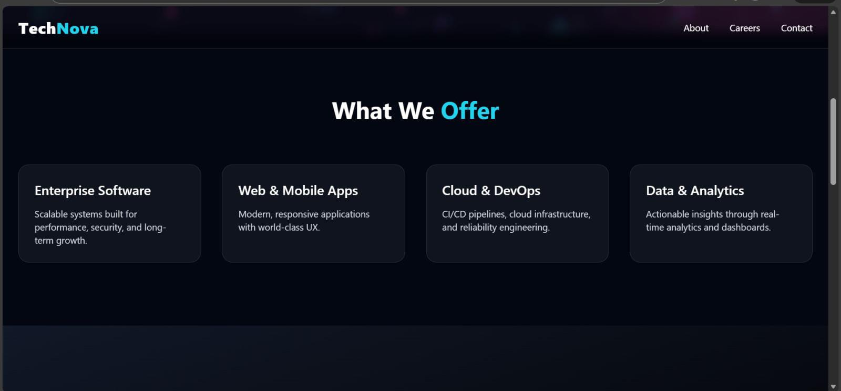
Services & Capabilities
Enterprise Software: Custom solutions for business scalability.
Cloud & DevOps: Modern infrastructure and automation services. ​
Web & Mobile Apps: High-performance digital products. ​

Slide 7
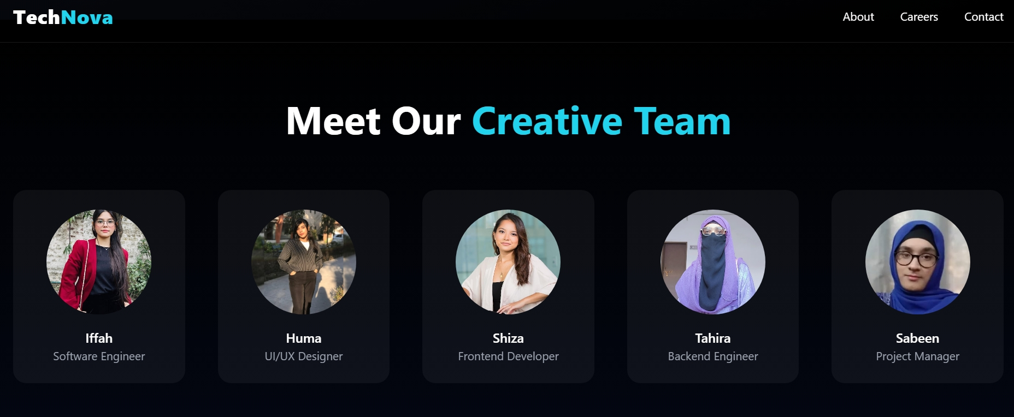
Team & Careers
Our Team: A collaborative group of five dedicated specialists.
​Opportunities: Real-time job listings to attract top tech talent.
​Culture: Promoting innovation and future-ready development.
Our Team: A collaborative group of five dedicated specialists.
​Opportunities: Real-time job listings to attract top tech talent.
​Culture: Promoting innovation and future-ready development.
Our Team: A collaborative group of five dedicated specialists.
​Opportunities: Real-time job listings to attract top tech talent.
​Culture: Promoting innovation and future-ready development.
Our Team: A collaborative group of five dedicated specialists.
​Opportunities: Real-time job listings to attract top tech talent.
​Culture: Promoting innovation and future-ready development.
Our Team: A collaborative group of five dedicated specialists.
​Opportunities: Real-time job listings to attract top tech talent.
​Culture: Promoting innovation and future-ready development.

Slide 8
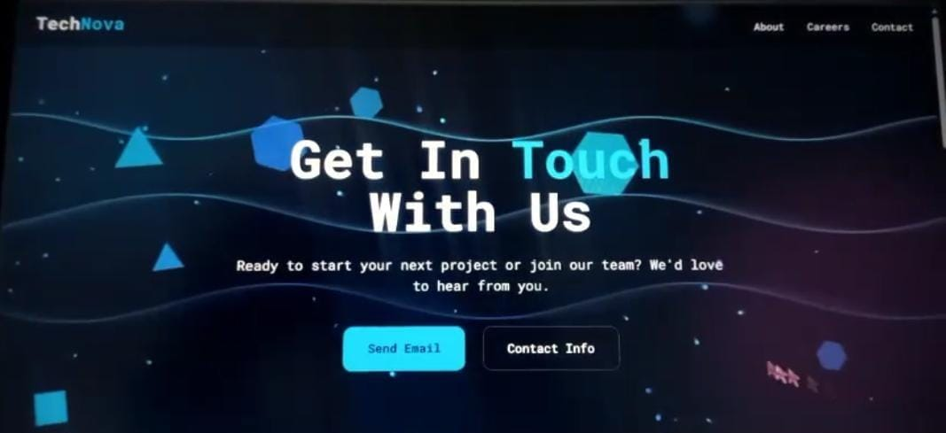
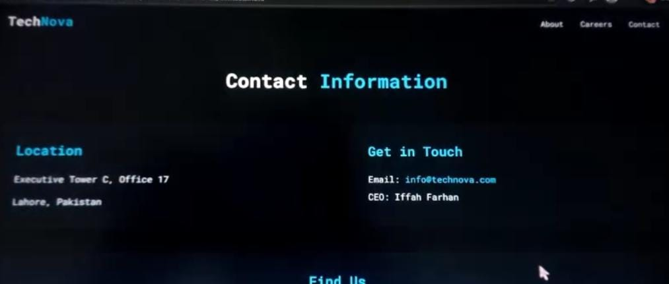
Contact Us
​Interactive Contact Form: A user-friendly form for project inquiries and support.
​Office Location: Strategically located at Executive Tower C, Lahore, Pakistan.​
Communication Channels: Integrated email and phone support for real-time client interaction.
​Map Integration: Embedded Google Maps to provide precise directions to our office.
​Modern Interface: A clean, dark-themed design consistent with the Tech Nova branding.

Slide 9
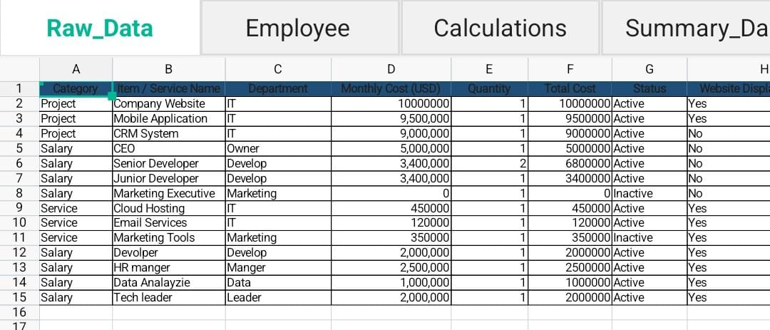
EXCEL DATA & ANALYSIS
Business Database: Managed a complete record of projects, services, and employee salaries.
​Service Tracking: Categorized items into Project, Service, and Salary for clear organization.​
Financial Analysis: Calculated Monthly Costs and Total Costs for each business asset.
​Status Monitoring: Used a 'Status' column to track Active vs Inactive services.​
Website Integration: Marked items intended for display on the live Tech Nova portal.

Slide 10
Design Decision
Futuristic Theme: Dark mode with professional neon accents.​
Typography: Consistent and readable fonts across all pages.
​Responsive Layout: Optimized for Mobile, Tablet, and Desktop.​
Data Integration: Logical link between website and Excel data.

Slide 11
LIVE DEMO & GITHUB
Live Website:
Source Code:

Slide 12

REFLECTION & NEXT STEPS
Integrated Workflow: Gained hands-on experience in linking web development with MS Excel for data-driven insights. ​
Technical Proficiency: Improved skills in Semantic HTML5, CSS Flexbox, and version control using GitHub. ​
​Future Enhancements: We plan to integrate an AI-powered project estimation tool and a real-time client dashboard in the next phase.
​Professional Growth: Learned the importance of professional presence through LinkedIn and GitHub Pages.

